Slide 1

Root of
Equations
Course : Scientific Computing
Year : 2023

Slide 2

Outlines
Root Findings in Python
Bisection Method
Newton–Raphson Method

Slide 3
Root of Equations
The root or zero of a function, f (x), is an xr such that f (xr ) = 0. The roots of equations may be real or complex. For functions such as f (x) = x2 −9, the roots are clearly 3 and −3. However, for other functions, such as f (x) = cos(x)− x, determining an analytic or exact solution for the roots of functions can be difficult.
The complex roots are seldom computed, because they rarely have physical significance. An exception is the polynomial equation
where the complex roots may be meaningful (e.g: analysis of damped vibrations). For now, we concentrate on finding the real roots of equations.

Slide 4
Root of Equations
All methods of finding real roots are iterative procedures that require a starting point. This estimate is crucial; a bad starting value may fail to converge, or it may converge to the “wrong” root (a root different from the one sought)
For these cases, it is useful to generate numerical approximations of the roots of any function f and understand their limitations. Methods commonly used are:
Incremental Search Method
Bisection Method
Linear Interpolation Based Method: Secant, False Position Method, and Ridder’s Method; and
Newton-Rhapson Method

Slide 5

Bisection Method
In engineering and science, error is a deviation from an expected or computed value. Tolerance is the level of error that is acceptable for an engineering application. A computer program has converged to a solution when it has found a solution with an error smaller than the tolerance.
The bisection method uses the intermediate value theorem iteratively to find roots until the error is acceptably low

Slide 6
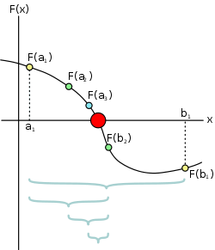
Bisection Method
Algorithm of Bisection Method :
If there is a root in the interval (a₁, b₁), then F(a₁) · F(b₁) < 0.
Compute F(b₂), where b₂ =(a₁ + b₁)/2
is the midpoint of the interval.
3. If F(b₁) · F(b₂) <0, then the root must be in (b₁, b₂), and we record this by replacing the original bound a₁ by b₂.
The root lies in (a₁, b₂), in which case b₁ is replaced by b₂. In either case,
the new interval (a₁, b₁), is half the
size of the original interval.
5. The bisection is repeated until the interval has been reduced to a small value ε, so that |b₁-a₁| ≤ ɛ

Slide 7
Bisection Method
It is easy to compute the number of bisections required to reach a prescribed Tolerance (ε). The original interval Δx is reduced to Δx/2 after one bisection, Δx/2² after two bisections, and after n bisections it is Δx/2^{n}, setting Δx/2 = ε and solving for n, we get

Slide 8
Bisection Method Example in Paper
Use bisection to find the root of f (x) = x³ − 10x² + 5 = 0 that lies in the interval (0.6, 0.8).
x | F(x) | interval
0.6 | 1.616 | -
0.8 | −0.888 | (0.6, 0.8)
(0.6 + 0.8)/2 = 0.7 | 0.443 | (0.7, 0.8)
(0.8 + 0.7)/2 = 0.75 | −0. 203 | (0.7, 0.75)
(0.7 + 0.75)/2 = 0.725 | 0.125 | (0.725, 0.75)
(0.75 + 0.725)/2 = 0.7375 | −0.038 | (0.725, 0.7375)
(0.725 + 0.7375)/2 = 0.73125 | 0.044 | (0.7375, 0.73125)
(0.7375 + 0.73125)/2 = 0.73438 | 0.003 | (0.7375, 0.73438)
(0.7375 + 0.73438)/2 = 0.73594 | −0.017 | (0.73438, 0.73594)
(0.73438 + 0.73594)/2 = 0.73516 | −0.007 | (0.73438, 0.73516)
(0.73438 + 0.73516)/2 = 0.73477 | −0.002 | (0.73438, 0.73477)
(0.73438 + 0.73477)/2 = 0.73458 | 0.000 | -
The final result
x = 0.7346
is correct within four decimal
Places, through 12 iterations

Slide 9
Bisection Method Example in Python
Use bisection to find the root of that lies in the interval (0,1) four-digit accuracy. How many function evaluations are involved in the procedure?

Slide 10
Bisection Method Example in Python
Use bisection to find the root of that lies in the interval (0,1) four-digit accuracy. How many function evaluations are involved in the procedure?
Therefore, the number of function evaluations in the for loop of bisection is [13.29]=14. There are an additional 2 evaluations at the beginning of the subroutine, making a total of 16 function evaluations.

Slide 11
Newton-Raphson Method
The Newton-Raphson formula can be derived from the Taylor series expansion of f (x) about x:
where O(z) is to be read as “of the order of z”. If xi+1 is a root of f (x) = 0, Eq. above becomes
Assuming that xi is a close to xi+1, we can drop the last term in Eq. and solve for xi+1. The result is the Newton-Raphson formula
The formula approximates f (x) by the straight line that is tangent to the curve at xi . Thus xi+1 is at the intersection of the x-axis and the tangent line.

Slide 12
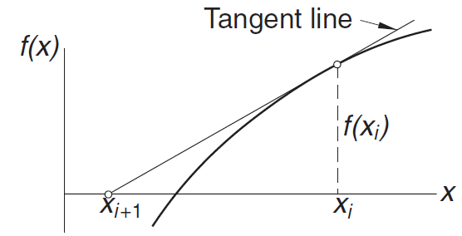
Newton-Raphson Method
The algorithm for the Newton–Raphson method is simple:
starting with an initial value x₀, until the convergence criterion.
is reached, ε being the error tolerance. Only the latest value of x must be stored. Here is the algorithm:
Let x be a guess for the root
of f (x) = 0.
2. Compute Δx = −f (x)/f ‘(x).
3. Let x ← x + Δx and repeat
steps 2–3 until |Δx| < ε.
The truncation error E in the Newton-Raphson formula can be shown to behave as
where x is the root

Slide 13



Newton-Raphson Method Example 1
A root of f (x) = x³ − 10x² + 5 = 0 lies close to x = 7. Compute this root with the Newton–Raphson method.
Solution
The derivative of the function is f (x) = 3x2 − 20x, so that the Newton–Raphson formula is
It takes only two iterations to reach five-decimal-place accuracy

Slide 14

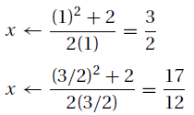
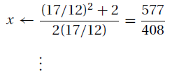
Newton-Raphson Method Example 2
Use the Newton–Raphson method to obtain successive approximations of √2 as the ratio of two integers.
Solution
The problem is equivalent to finding the root of f (x) = x² − 2 = 0. Here the Newton–Raphson formula is
Starting with x = 1, successive iterations yield
Note that x = 577/408 = 1.1414216 is already very close to √2 = 1.1414214

Slide 15
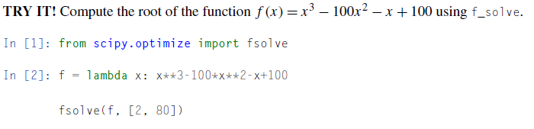
Root Findings in Python
Unsurprisingly, Python has root-finding functions. The function we will use to find roots is f_solve from the scipy.optimize. The f_solve function takes in many arguments (study the documentation for addition information), but the most important two are:
The function that you want to find the root
The initial guess.

Slide 16
Summary & Exercise
Roots are an important property of functions.
The Bisection method is a way of finding roots based on divide-and-conquer. Although stable, it might converge slowly
The Newton–Raphson method is a different way of finding roots based on an approximation of the function. Although the Newton–Raphson method converges quickly and stops near to the actual root, it can be unstable.
Find the smallest positive (real) root of x³ − 3.23x² − 5.54x + 9.84 = 0 by the method of bisection.
The equation x³ − 1.2x² − 8.19x + 13.23 = 0 has a double root close to x = 2. Determine this root with the Newton–Raphson method within four decimal places.

Slide 17
Summary & Exercise
Roots are an important property of functions.
The Bisection method is a way of finding roots based on divide-and-conquer. Although stable, it might converge slowly
The Newton–Raphson method is a different way of finding roots based on an approximation of the function. Although the Newton–Raphson method converges quickly and stops near to the actual root, it can be unstable.
Find the smallest positive (real) root of x³ − 3.23x² − 5.54x + 9.84 = 0 by the method of bisection.
The equation x³ − 1.2x² − 8.19x + 13.23 = 0 has a double root close to x = 2. Determine this root with the Newton–Raphson method within four decimal places.

Slide 18
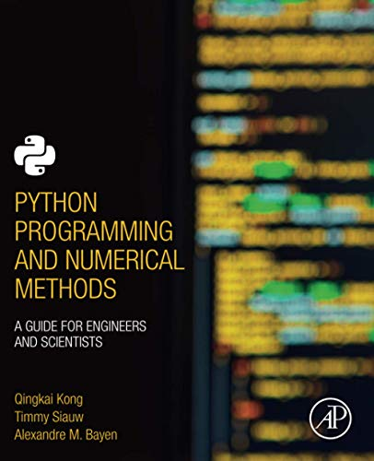
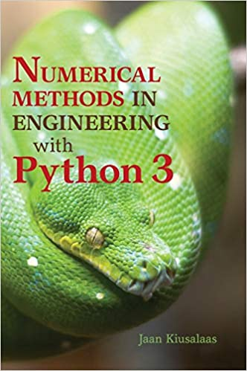
Acknowledgement
These slides have been adapted from: Kong, Q., Siauw, T., & Bayen, A. M. (2021). Python Programming and Numerical Methods: A Guide for Engineers and Scientists. Academic Press. ISBN: 978-0-12-819549-9 Kiusalaas, J. (2013). Numerical Methods in Engineering with Python 3. United Kingdom: Cambridge University Press. ISBN:9781107033856

